Slide 1
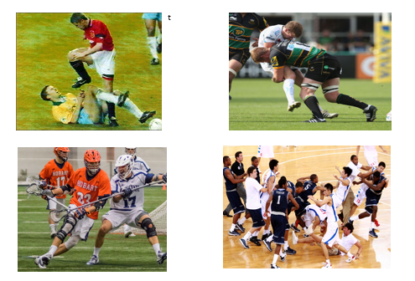
Violent
Non Violent
Non Violent
Violent

Slide 2
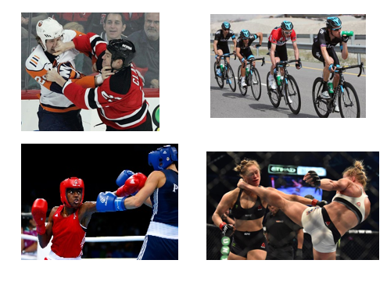
Violent
Non Violent
Non Violent
Violent

Slide 3
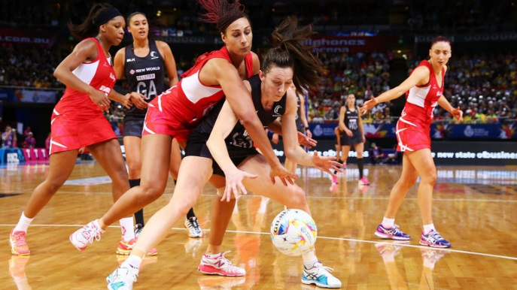
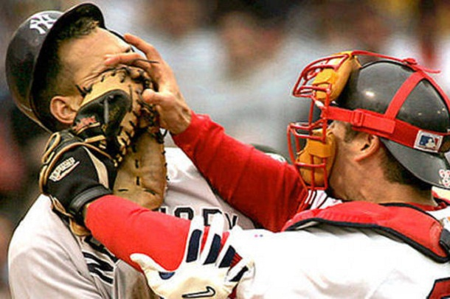
Non Violent
Violent

Slide 4

What did you score??
There was 10 points available in this activity.
What did you score out of 10?
Can you work that out as a percentage?

Slide 5
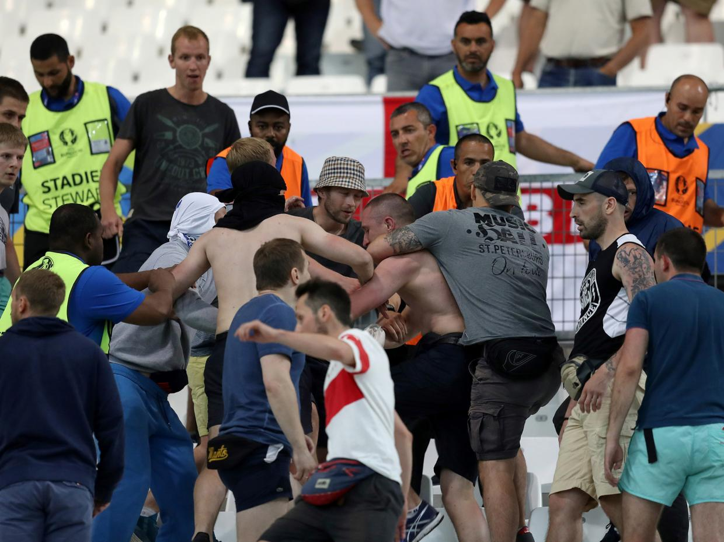
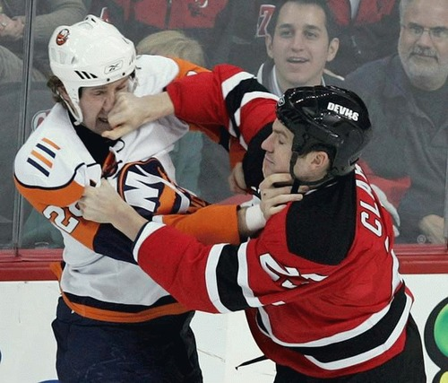
Violence in sport

Slide 6
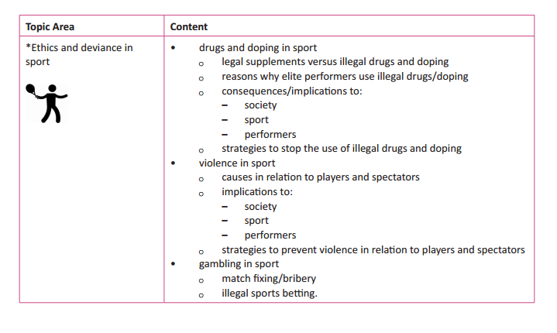

Slide 7
Learning outcomes
LO1 : To be able to identify the causes of violence in relation to players and spectators.
LO2: To be able to explain what the implications of violence on the sport, society and performers.
LO3: To identify strategies to prevent violence in relation to players and spectators.

Slide 8
How do we define violence?
On your mini whiteboards, can you and your partner write me a definition of violence.
Violence: Physical force that is directed towards harming another individual or groups of individuals and can cause injury or death.

Slide 9

Causes of violence
You must be able to identify the causes of violence in sport.
On your mini whiteboards when I say go. Try to name as many causes for violence in sport as you can.
You will have 1 minute.
http://www.online-stopwatch.com/countdown-timer/

Slide 10
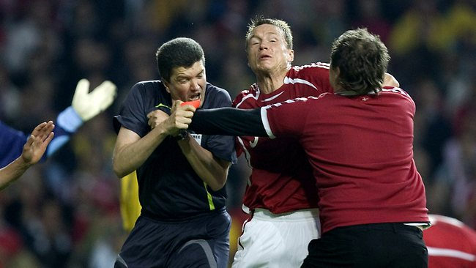
Causes of violence in sport
Type of sport
High levels of competition – emotional responses
Alcohol or drugs (social and sports enhancing).
Rivalry between different groups.
Copying violence of role models/performers
Social media
Perceptions of poor officiating
Access to weapons
Overcrowding in the stadium

Slide 11
Activity
In pairs can you create two piles with the 10 white pieces of paper on your desk.
Do you think it is a cause of violence by players or spectators?
You will have 2 minutes to do this activity….
Pile for spectators
Pile for players

Slide 12
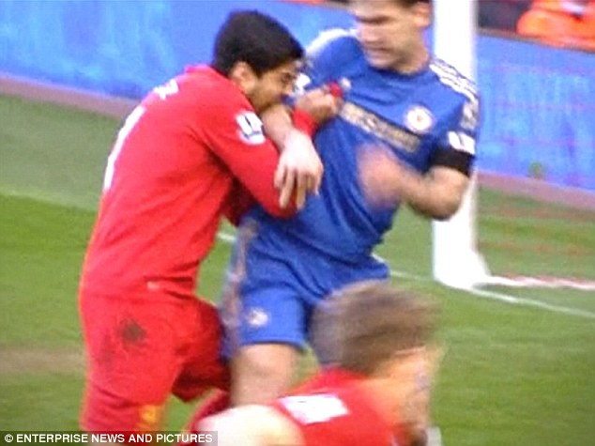
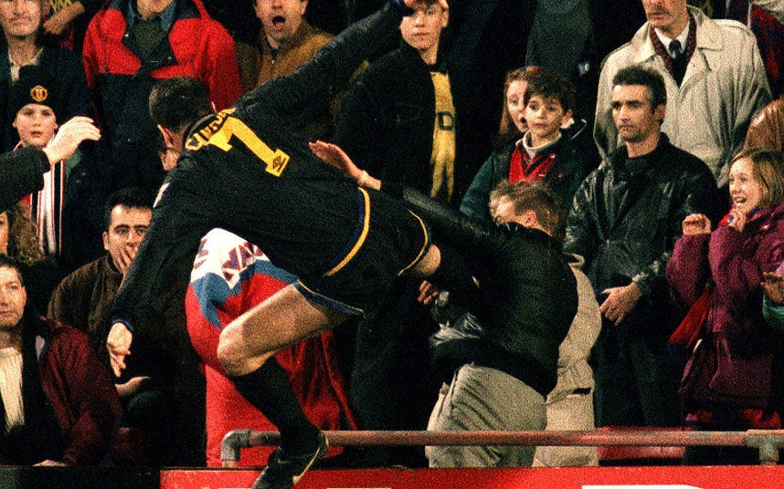
Causes of violence in sport - Players
Type of sport
High levels of competition – emotional responses
Drugs use (steroids)
Perceptions of poor officiating
Abuse or provoked
Access to weapons has potential to cause violence.

Slide 13
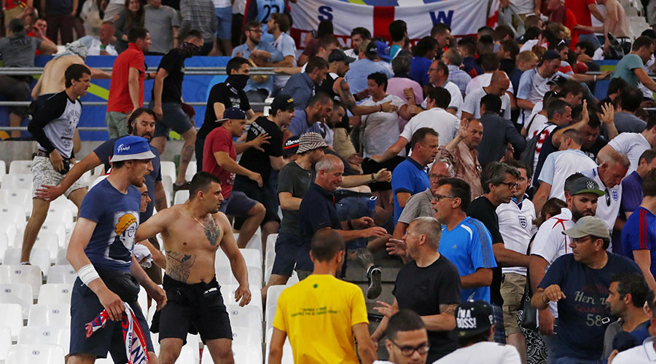
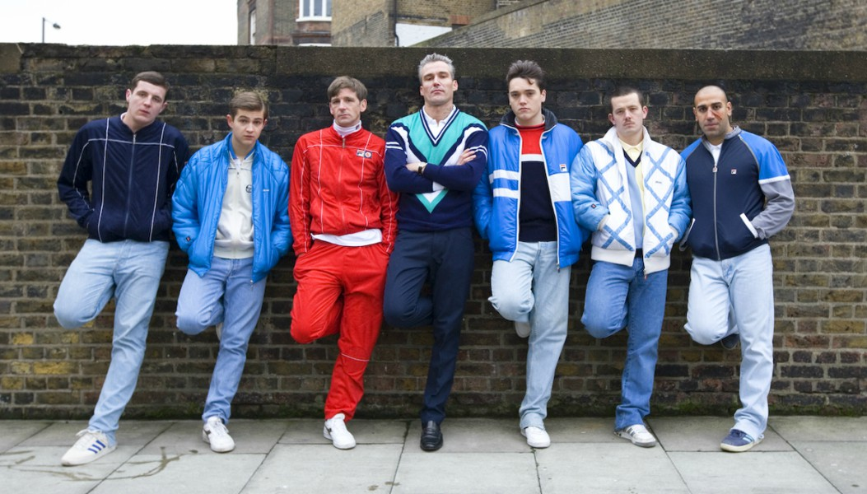
Causes of violence in sport - spectators
Copying violence of role models/performers
Social media
Alcohol or drug use
‘Deindividuation’ – spectators become part of a group rather than an individual. Actions/behaviour is defined by a group. Mob culture.
Overcrowding in a stadium.

Slide 14
Spectators
Players
Type of sport
High levels of competition – emotional responses
Drugs use (steroids)
Perceptions of poor officiating
Abuse or provoked
Access to weapons has potential to cause violence.
Copying violence of role models/performers
Social media
Alcohol or drug use
‘Deindividuation’ – spectators become part of a group rather than an individual. Actions/behaviour is defined by a group. Mob culture.
Overcrowding in a stadium.

Slide 15

Fold your pink A3 sheet.
We are going to do a quick true or false game to assess your knowledge of causes of violence in sport.
Green card = true
Red Card = false

Slide 16
True or false….
Overcrowding in a stadium is a cause of violence by players?

Slide 17
True or false….
Copying of violence and role models in sport is not a cause of violence by spectators?

Slide 18
True or false….
Alcohol in sport is a cause of violence by spectators?

Slide 19
True or false….
Drugs are cause of violence by players??

Slide 20
True or false….
High levels of competition is not a cause of violence by players?

Slide 21
Implications of violence in sport
You must be able to identify the implications of violence in sport in relation to society, sport or spectators.
In you pairs just consider what is meant by implications of violence?
Can you write a definition on your mini whiteboards.

Slide 22
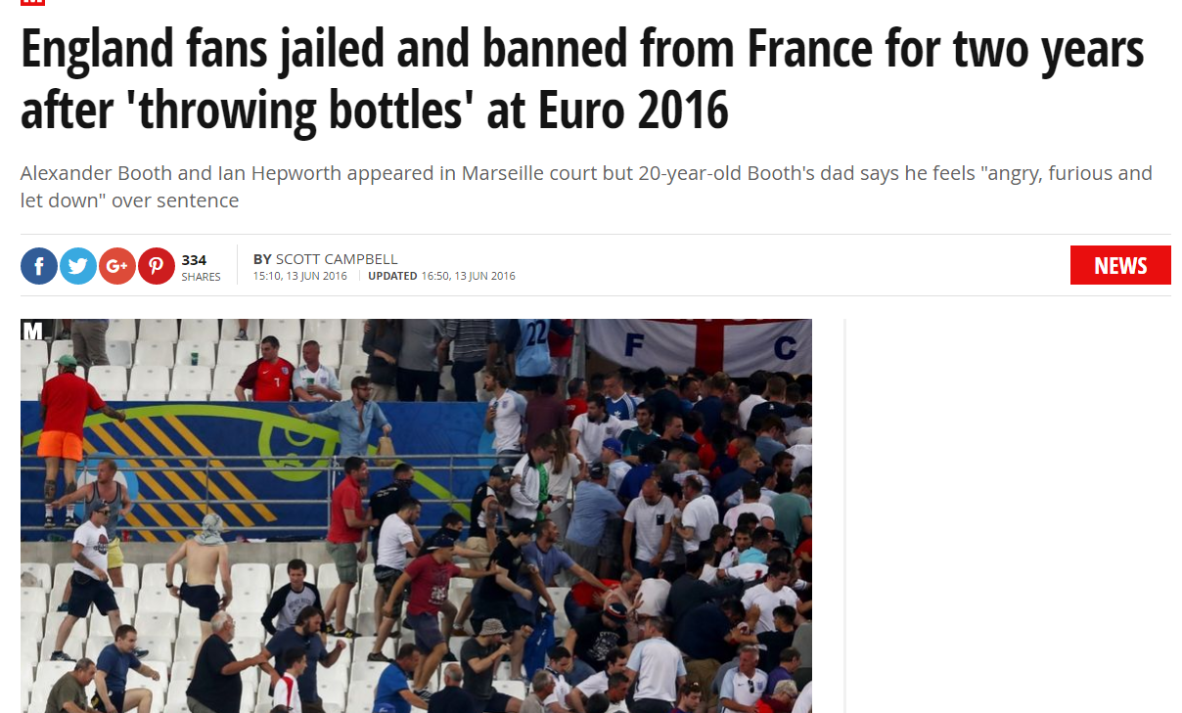
Implications of violence in sport
This is the ‘conclusion/outcome’ of actions that are intended to harm someone or a group in a sport environment.
https://www.youtube.com/watch?v=uyROfCabUTs

Slide 23
Activity
In your pairs on your mini whiteboards consider the implications of violence to:
Row A : Society
Row B: Sport
Row C: Players
You will have 5 minutes to consider the implications and write them down. Write as many as you can down.
You should link the implications to causes that we have already covered.
You could think of famous sporting violence that has lead to real implications.

Slide 24
Implications of violence in sport - Society
Many people believe that sport should be recognised as a mirror to our society and behaviour within sport is influenced by society’s norms and values via socialisation. Therefore, if violence is to be tackled in sport, then violent behaviour in society should be tackled.
On society:
Spectators often relish watching violence in sport as it as part of the entertainment in some sports. Eg- rugby, MMA, boxing.
Creates poor role models for observers.
People will copy the performance in society.
Creates a holistic/violent environment to groups that watch the game.
Bad reputation for the sport.
Causes horrendous scenes (eg. France 2016)

Slide 25
Implications of violence in sport - performers
Performers can be considerably harmed due to violence in sports.
Sports people are likely to be punished by NGB’s if they are seen to have acted violently.
These punishments could cause; fines or bans.
Violence will become a reoccurring issue when these performers are playing.
Ruin a match or competition.

Slide 26
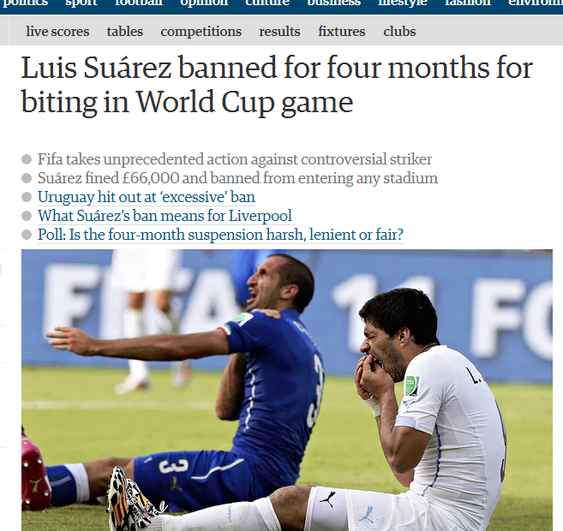
https://www.youtube.com/watch?v=S0kJlCjgQ4g

Slide 27
Implications of violence - sport
Sports are associated with violence and deviance. This can have a positive and negative effect on the reputation of the sport and how many spectators it acquires.
May decrease the number of people participating in the sport.
May get a bad reputation for the sport.
Other players or supports may believe this is acceptable behaviour.
Sports people are role models and behaviour will be copied or replicated.

Slide 28
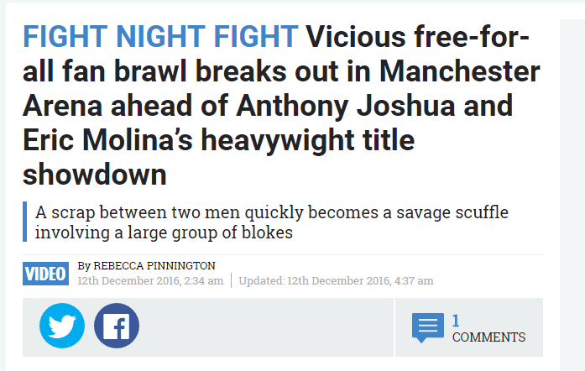

Slide 29
Society
Performers
Sport
Spectators often relish watching violence in sport as it as part of the entertainment in some sports. Eg- rugby, MMA, boxing.
Creates poor role models for observers.
People will copy the performance in society.
Creates a holistic/violent environment to groups that watch the game.
Bad reputation for the sport.
Causes horrendous scenes (eg. France 2016)
Performers can be considerably harmed due to violence in sports.
Sports people are likely to be punished by NGB’s if they are seen to have acted violently.
These punishments could cause; fines or bans.
Violence will become a reoccurring issue when these performers are playing.
Ruin a match or competition.
Sports are associated with violence and deviance. This can have a positive and negative effect on the reputation of the sport and how many spectators it acquires.
May decrease the number of people participating in the sport.
May get a bad reputation for the sport.
Other players or supports may believe this is acceptable behaviour.
Sports people are role models and behaviour will be copied or replicated.

Slide 30
Activity
In your pairs attempt to think of as many strategies to prevent violence in sport from occurring in relation to players.
You will have 2 minutes.

Slide 31
Strategies to prevent violence - players
The laws society sets to control violence by treating a violent action in sport the same as a violent act is in society, stating the law should be equal for both instances.
Performers should be educated to avoid violence and control their emotions (link to stress management).
Performers should understand that they are role models, they should promote fair play philosophy and rules of the game.
Violence leads to punishments such as; fines, bans and some cases criminal investigation. (Often most powerful motive). Teams can also be punished by NGB’s eg; points deducted or eliminating them from competition.
Effective officiating can avoid violence; eg in rugby preventing a situation before it happens. Some sports use video footage from games to punish violent conduct after a competition also.
Coaches or managers promoting assertion not aggression.
Camera’s and microphones on referee’s in rugby cuts out violence towards officials.

Slide 32
Activity
In your pairs attempt to think of as many strategies to prevent violence in sport from occurring in relation to spectators.
You will have 2 minutes.

Slide 33
Strategies to prevent violence - spectators
Law enforcement prevents violence from happening before it potentially unfolds. Football spectators act 1989 allows police to arrest people that may be identified as hooligans/troublemakers, preventing them from travelling to games abroad.
The police may also apply bans to allow fans from attending matches at home or away. A football banning order may be made on conviction for a relevant offence or a civil application based on past violent conduct which was not convicted for.
Technological advances has decreased the amount of violence. CCTV/ Handheld or body cameras by the police.
Use of media and promotion of friendly rivalry between teams before fixtures.
Ensure that stadiums are not over sold to prevent overcrowding of fans.

Slide 34
Fold your pink A3 sheet.
We are going to do a quick true or false game to assess your knowledge of strategies to prevent violence.
Green card = true
Red Card = false

Slide 35
True or false….
Performers should be educated to control their aggression to prevent violence in sport?

Slide 36
True or false….
Law enforcement can not stop football fans from travelling abroad to games?

Slide 37
True or false….
Coaches and managers do not have control over the actions their players make.

Slide 38
True or false….
Technological advances is a strategy to prevent both player and spectator violence in sport?

Slide 39
True or false….
Violence caused by recreational drugs and alcohol can not be prevented in sport?

Slide 40
Activity
On the white A4 sheet there is 4 table’s (labelled clip 1, clip 2).
I will show you 4 clips. You must write down what happened and explain in detail what happens in the clip.
After I have played all 4 clips, you and your partner can fill in the tables as to what you think the causes, implications and strategies to prevent this violence from happening again are.

Slide 41
Example
https://www.youtube.com/watch?v=ns5_qNBxXTA
Who does it involve? What happened?
Causes?
Implications?
Strategies to prevent?

Slide 42
Video clips:
Clip 1 : https://www.youtube.com/watch?v=EbJk62ukCVE
Clip 2: https://www.youtube.com/watch?v=Hp8Tb2gWwRo
Clip 3: https://www.youtube.com/watch?v=Pv2N0kK6zbw
Clip 4: https://www.youtube.com/watch?v=4WcvUrNuZ4U

Slide 43
https://www.youtube.com/watch?v=wDo26ZqUO48 (roy keane)
https://www.youtube.com/watch?v=Uy31pdfntUw (Suarez )

