Slide 1
Supporting Visual Impairment
Beth Elkins
Personal Support Manager
Cambridge Regional College

Slide 2
Aims
Conditions of the eye and their effects
Impact of sight loss and blindness on orientation and day-to-day living
Impact of sight loss and blindness on communication
Supporting Students in the learning environment

Slide 3
Effects of Eye Conditions
Blurred vision
Colour blindness
Range of vision
Distance
Light
Access Text
Stable or Degenerating
Onset

Slide 4
Impact of Sight Loss in the UK
Approximately 2,000,000 people in the UK have an uncorrectable sight loss
  4% of these are totally blind
  14% have a perception of light
  82% have some useful vision
Visual Impairment experienced mostly by older people
  1 in 12 over 60yrs old rises to 1 in 5 over 75yrs old
Four most common eye conditions
  Glaucoma
  Cataracts
  Age-related Macular Degeneration
  Diabetic Retinopathy

Slide 5
Effects on Orientation and
Day-to-Day Living
Orientation
  Getting to college
  Familiarisation with environment and routes
  Confidence with stairs
  Obstacles
  Lighting
  Contrast
  Cane
  Sighted-guide
  Guide Dog
Day-to-Day Living
  Getting ready
  Appearance
  Preparing and eating food
  Making purchases
  Independence
  Work
  Finances
  Emotions

Slide 6
Effects on Communication
93% of communication non verbal
  Body movements, facial expression, eye gaze
  Paralinguistic cues
Appearance
Formal and non-formal situations
Who’s there?
Informal learning affecting culture:
  Posters
  Headlines
  Notices
  Web-Surfing

Slide 7
Supporting Students
Listen to your student!
  How much can you see?
  How can we enable you to make best use of your sight?
  Encourage participation in writing support plans
  Seek participation in the review of support plans, with amendments when needed

Slide 8
Remove Barriers
Make visual information accessible
Emphasise text
Provide accessible technologies
  Screen Readers
  Screen enlargers
  Electronic video magnifiers
  Audio Technology
Make information tactile
Provide information in advance
Provide support!

Slide 9
Teaching Strategies
Ensure learning environment is accessible and safe
  Remove hazards
  Check lighting
  Check layout of room
Speak clearly – VI students rely on verbal information
Keep information concise and specific
Read aloud any visual materials
Do not rely on visual cues
Be positive – a smile can be heard!

Slide 10
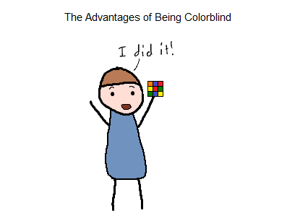
“The best and most beautiful things in life cannot be seen, not touched, but are felt in the heart”.
Helen Keller

