Slide 1
Understanding ADHD
Beth Elkins
Personal Support Manager
Cambridge Regional College

Slide 2
ADHD
Attention Deficit Hyperactivity Disorder
  ADD – Attention Deficit Disorder
  Hyperactivity
Neuro-behavioural Developmental Disorder of the Frontal Lobe
Executive Functioning Disorder
“All I have ever experienced is a foggy brain or thoughts leaping about or something like "mental stuttering" when I really try to focus”

Slide 3
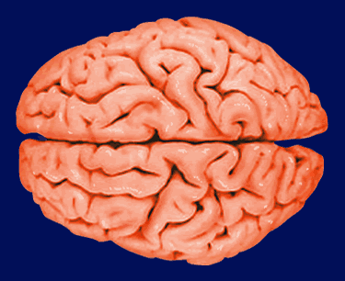
How the Brain Works
Parietal
  Physical feelings –
  hot/cold/rough/smooth
Occipital
  Sight
Temporal
  Hearing and speaking
Frontal
  Coordinating the brain’s activity, ordering information and moving the body physically
  Executive functioning, planning, behaviour, working memory, attention, restlessness, thoughts, moods and language
Notes:
Par eye ital. Oc sip ital. In other words, when playing a video games, the parietal lobe feels the buttons, the occipital lobes sees what’s happening on the screen, the temporal lobe hears the sounds effects and the frontal lobe orders the information so I can play the game in response to the events and remain focussed.

Slide 4
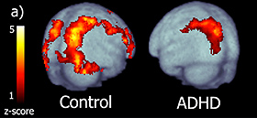
What is ADHD?
Neurons and Neurotransmitters
  Noradrenaline – focus
  Dopamine – attention
Physiological differences in the brain affecting executive functioning
There are fewer neurotransmitters to:
  tell the temporal lobe to listen
  tell the occipital lobe to stop staring out of the window
  tell the parietal lobe to stop fidgeting
Without these, the frontal lobe has nothing to coordinate; less brain activity, less control
A genetic condition
Notes:
Neurons are the postmen
Neurotransmitters are the messages
Less brain function means less attention and focus
Executive functioning describes a set of cognitive abilities that control and regulate other abilities and behaviours. Executive functions are necessary for goal-directed behaviour. They include the ability to initiate and stop actions, to monitor and change behaviour as needed, and to plan future behaviour when faced with novel tasks and situations. Executive functions allow us to anticipate outcomes and adapt to changing situations. The ability to form concepts and think abstractly are often considered components of executive function.

Slide 5
Signs of ADHD
Moving about a lot/fidgeting/restlessness
Doing things impulsively – no ‘stop and think’ mechanism
Losing interest very quickly (if interest gained at all)
Short-term memory issues
Heightened emotions
Easily distracted
Inability to hear what is being said
Disorganisation
Interrupting
Anger/confrontational tendencies
Frustration
Notes:
Fidgeting is the body’s way of activating under-stimulated brains; this aids focus. So if a learner needs to fiddle with paper, get up and move about or chew – let them! They won’t be able to concentrate without this!

Slide 6
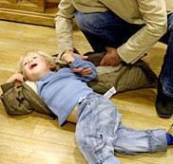
What ISN’T ADHD?
Another name for badly behaved
children
A result of poor parenting
A curable condition
A condition preventing people making friends
A condition that will be outgrown in adulthood
Entirely controlled with diet
A new “fashionable” condition
Notes:
Although ADHD does effect behaviour and therefore people with ADHD are classed as naughty children, their body/brain simply won’t put the brakes on something they know to be wrong until after the event...
Parenting does come under fire – 10 things you would never accept, you start to pick your battles. Can appear to be lack of discipline to outsiders, but actually it is filtering of behaviours with slightly more emphasis on relationship rather than perfect behaviour.
Certainly treatable, with mixture of behaviour management, possibly medication, OT, play therapy, speech and language therapy, support at school to work on focus. Not curable, in that it won’t go away with a drug and not all drugs work on all children.
Making friends is easy – a lot of kids with ADHD are quite confident and impulsive which attracts other children. It’s keeping them that’s hard, because of the impulsive nature of ADHD and the hitting out that sometimes happens.
Generally speaking, adults with ADHD have learned strategies to help them manage their condition. They won’t work in a job that requires them to sit still all day, so moving around doesn’t stand out so much. They’re often hilarious, because they've learned to be the ‘class clown’. They may not have achieved so well at school and will be very successful in more practical environments, but they may pick up tools and use them inappropriately, getting them into lots of trouble for something stupid and impulsive.
Some experts feel that ADHD is entirely diet-based. However, although cutting some elements from some people’s diets have resulted in calmer behaviour and more focussed attention, for others it makes no difference at all. Parents will often avoid E numbers, fizzy drinks, dairy and processed food, but if ADHD exists as a co-morbid condition and the child also has Autism or OCD, changing diet may be more of a challenge than it’s worth for the outcome.
This is not a new diagnosis to explain the bad behaviour and lack of discipline of an increasing number of students. This has been identified since 1902 (first document and researched case) by Professor George Frederick Still – see next slide

Slide 7
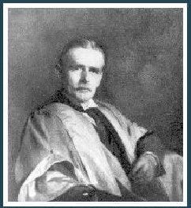
Professor George Frederick Still
In 1902, Professor Still delivered 3 lectures to the Royal College of Physicians, in which he described:
“43 children who had serious problems with sustained attention and self-regulation, who were often aggressive, defiant, resistant to discipline, excessively emotional or passionate, who showed little inhibitory volition, had serious problems with sustained attention and could not learn from the consequences of their actions; though their intellect was normal”

Slide 8
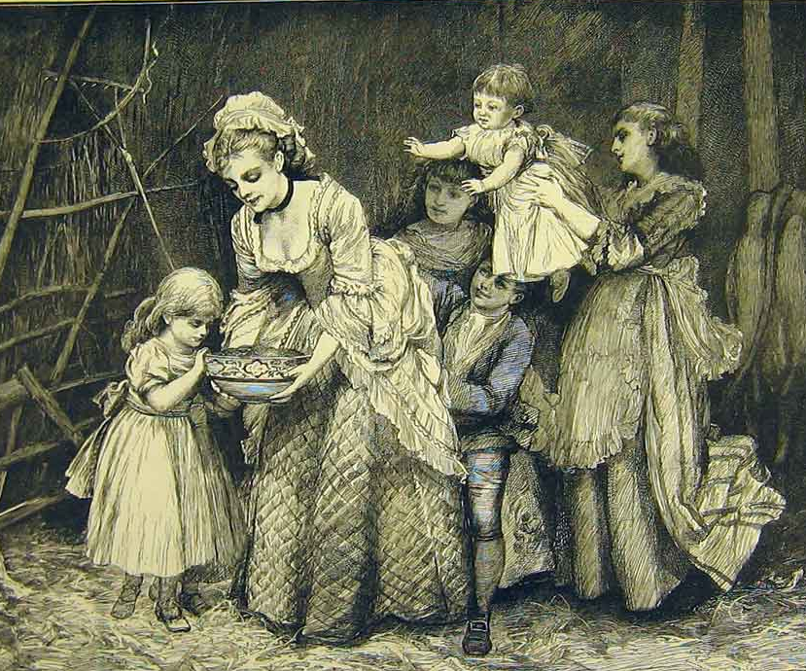
History
Since then, ADHD has been
described as:
1930 Brain Injury
1950 Hyperactive Childhood Syndrome
1960 Minimal Brain Dysfuntion
1965 Hyperkinetic Child Syndrome
1975 Attention Deficit Disorder
1987 Attention Deficit and Hyperactivity Disorder

Slide 9
Treatment and Support
Learners with ADHD need
Time
Patience
Alternative learning routes
Clarity around tasks
Coping strategies
Opportunities for success
Realistic Expectations
Challenges in fun and positive ways
Task breakdowns
Routine
Trigger recognition and time out opportunities
Understanding
Praise and positivity
Notes:
20 steps to doing homework.
Get your book
Get it home
Remember that you have homework to do
Get it out of your bag
Get the assignment brief out of your bag
Locate the right place in the book to do the assignment
Work on it – concentrate on completing the task – sit still to do it
Finish it
Return book to bag
Put bag by the door
Take bag to school
Remember to get book out of bag to hand in
All relating to executive skills. So ADHD children learn to get very good at excuses and are judged for being manipulative, lazy or ‘falling back on their condition as an excuse’. They’d rather say I shan’t do it than I can’t do it.

Slide 10


Slide 11
Ideas for Further Discussion
In your view, what is the biggest challenge faced by people with ADHD?
What changes could you make easily to the way your lessons are run to meet the needs of learners with ADHD?
What do you understand by the term ‘positive reinforcement’ and how could you make this a focus in your teaching and learning?

Slide 12
Your motto....?
If you live with encouragement.... You learn confidence
If you live with tolerance... You learn to be patient
If you live with criticism... You learn to condemn
If you live with hostility... You learn to fight
If you live with security... You learn to have faith
If you live with approval... You learn to like yourself
If you live with fairness... You learn justice
If you live with ridicule... You learn to be shy
If you live with praise... You learn to appreciate
If you live with shame... You learn to feel guilty
If you live with acceptance You learn to find love in
and friendship... the world

