Slide 1
Deaf Awareness Training
Beth Elkins
Personal Support Manager
Cambridge Regional College

Slide 2

Aims
Be able to use the right language
Understand the impact of different levels of deafness on communication
Describe some techniques to make lip reading easier
Describe the limitations of hearing aids
Teaching Strategies

Slide 3
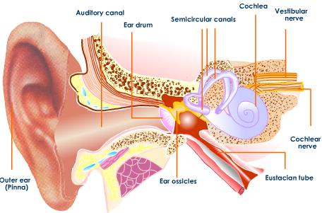
Structure of the Ear
Notes:
Ear Ossicles – malleus (hammer), incus (anvil) and stapes

Slide 4
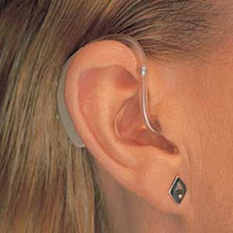
What does “deaf” mean?
Conductive / Perceptive
  Outer/ Middle / Inner Ear
Mild
Moderate
Severe
Profound
D/deaf
Hard of Hearing
Sign Language User (Deaf)
Deafened
Hearing Aid User
Cochlear Implant User
(Hearing Impaired)

Slide 5
Impact of Deafness
1 in 7 people have a hearing loss
Approximately 2 million people in the UK use hearing aids
Most deafness is experienced by older people
There are an estimated 23,000 Deafblind people
There are an estimated 123, 000 Deafened people
Only 70,000 use British Sign Language in the UK

Slide 6
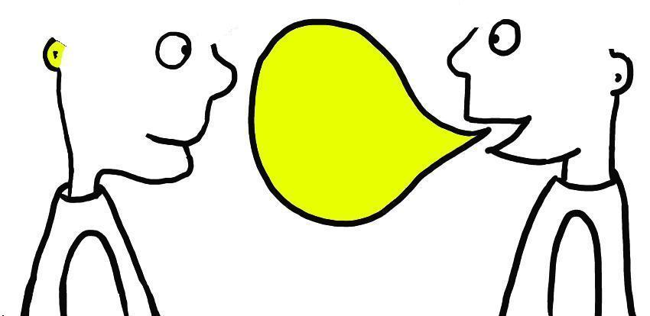
Impact on Communication
Development of language from birth
Understanding of alternative meanings
Missing the ‘smaller’ parts of language
Missing the endings or beginnings of words they can’t hear
Speech and hearing are important parts of communication and both are affected
Links with age
Phonetic spellings
Word order/grammar

Slide 7
Example of Deaf person’s written English
Sometimes notetakers need improved for their write notes skills. For example; some of notetakers who wrote too much deeply English sentences cause difficult to understand or can't be bother to read as I prefer read simple English and understand quickly. Also I dislike difficult to read notetakers' write style like bit mess or bit complex fonts, as I like notetakers' writing looks like Arial font cause easier to read.

Slide 8
Make lip-reading easier
Make sure the light is on your face
Use normal lip patterns
Speak slightly more slowly
Use brief, but comprehensive, sentences
Introduce the topic first
Make maximum use of facial expression, eye gaze, body language and gesture to get your point across

Slide 9
Limitations of Hearing Aids
They do not work like glasses
They amplify everything
With a perceptive loss, sound might be louder, but it’s still distorted
Loop systems
Radio Aids

Slide 10
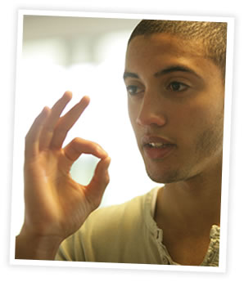
British Sign Language
Not the same as English
Rich, colourful, visual language with its own grammar and structure
Finger-spelling
Facial expressions, body language and movements, mouth patterns, movement of signs, gestures
and multi-channel signs

Slide 11
Teaching Strategies
Talk to the students, not the board!
Make sure the classroom is arranged appropriately
Provide notes in advance in clear, simple language
Keep background noise to a minimum
Check the lighting
Ensure any Support Worker is accommodated within the classroom and used as a way of communicating directly with your student

Slide 12
“I don’t view myself as having a disability…
I function like any other hearing person can. My deafness does not deprive me of anything.
I can do anything I want...
Except maybe sing.”
Summer Cider (Gallaudet University Recruiter)

